Slide 1

Data Management Python training
Nikolas Afxentiou
School of Engineering, Frederick University, Cyprus
February 2025

Slide 2
Table of contents
1. Introduction
2. Graphical User Interface
3. Step-by-step user guides
2

Slide 3

1. Introduction
Scope
Learn to access and extract data from the SERG platform.
Categorize data (e.g., Energy Metering, IAQ).
Select relevant timeframes and intervals for analysis.
Apply Python scripts for data processing and refinement.
Visualize data effectively using graphs and charts.

Slide 4
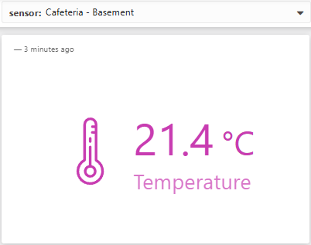
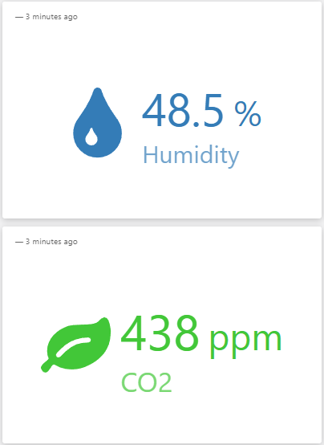
1. Introduction (cont.)
Access the SERG Platform
Login via SERG Platform.
Download and extract required data.
Data Categorization
Focus on categories such as Energy Metering or IAQ.
Timeframe and Interval Selection
Choose the specific time period and interval for analysis.
Post-Processing and Visualization
Apply algorithms and Python scripts for processing.
Visualize data with graphs and charts.

Slide 5
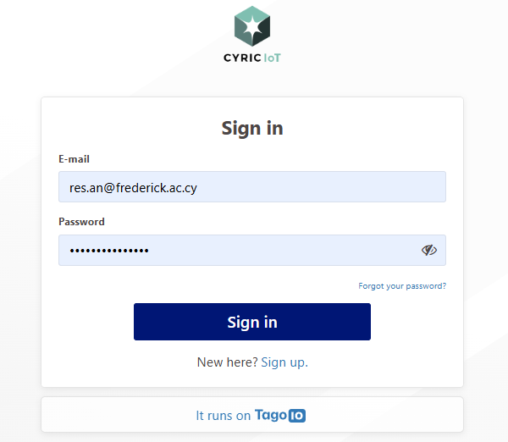
2. Graphical User Interface – SERG Platform
Navigate through the: https://cyric-iot.tago.run/auth/login

Slide 6
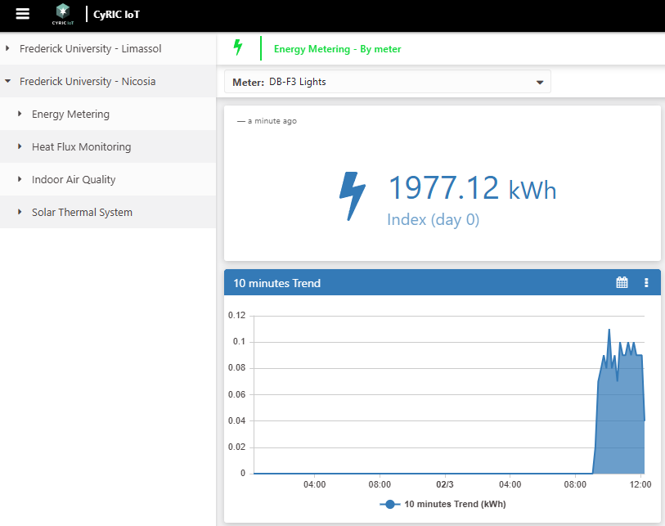
2. Graphical User Interface – SERG Platform

Slide 7
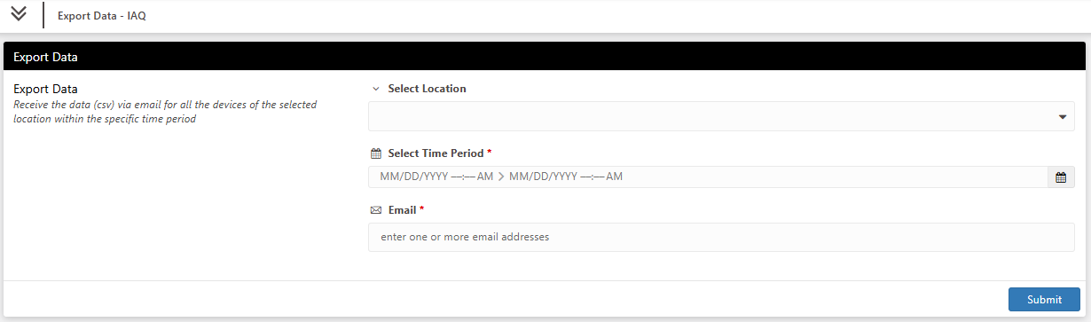
2. Graphical User Interface – SERG Platform

Slide 8
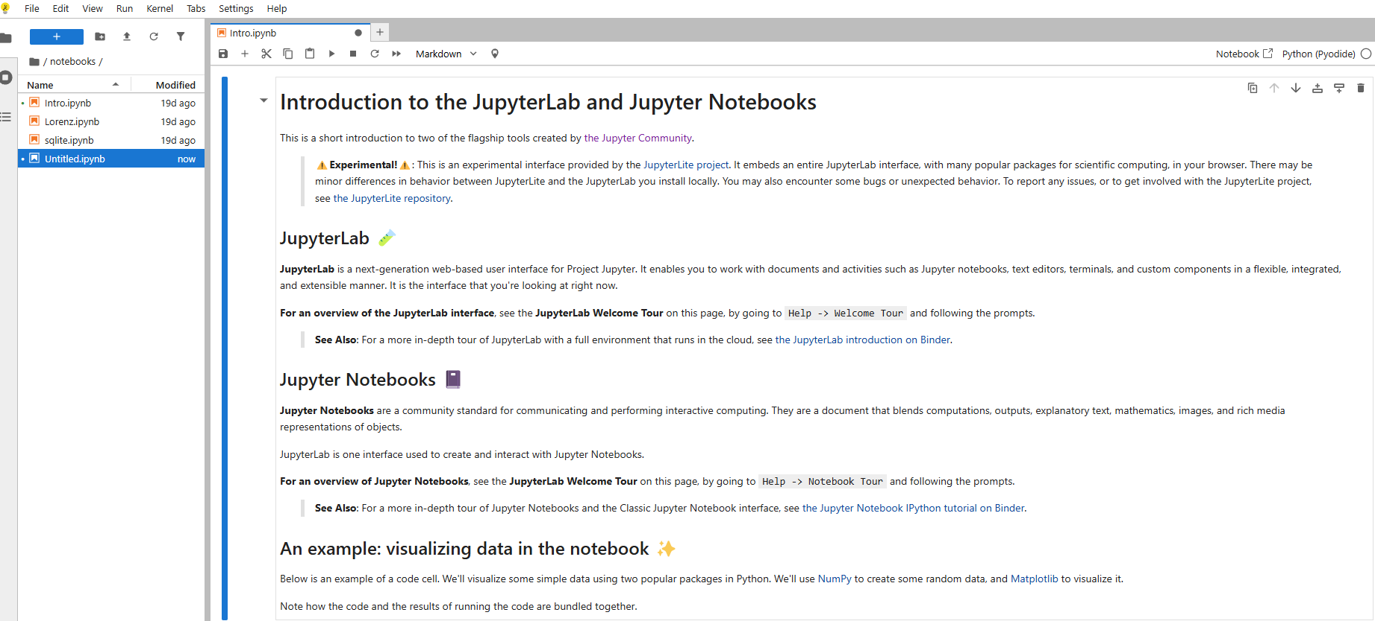
2. Graphical User Interface - JupyterLab
Navigate through the JupyterLab: https://jupyter.org/try-jupyter/lab/

Slide 9
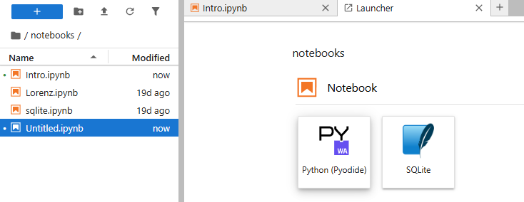
2. Graphical User Interface - JupyterLab
Navigate through the JupyterLab: https://jupyter.org/try-jupyter/lab/

Slide 10
3. Step-by-step User Guide
Navigate through the JupyterLab:
https://jupyter.org/try-jupyter/lab/
GitHub repository for the source code
https://github.com/NicholasAfxentiou/Python.git

Slide 11
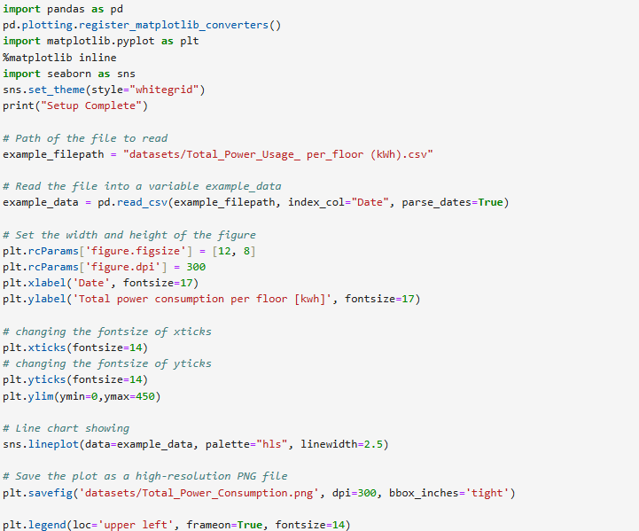
3. Time Series – Energy Metering

Slide 12
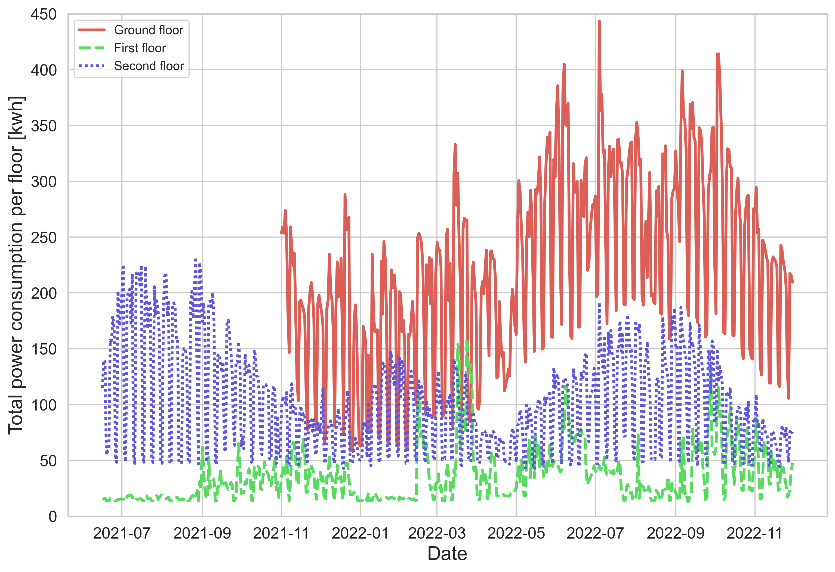
3. Figure

Slide 13
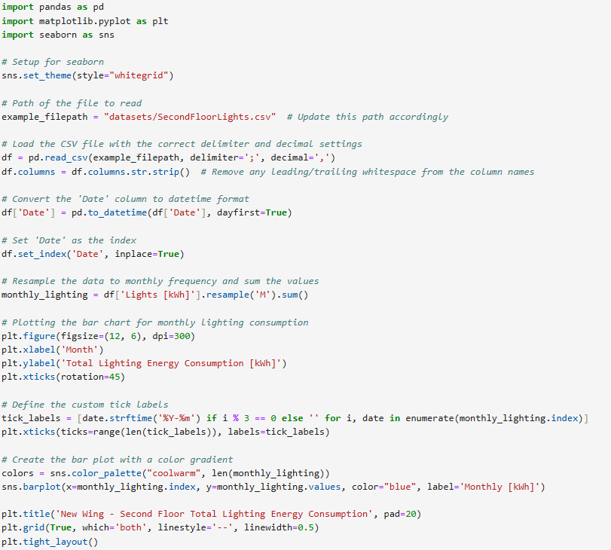
3. Bar Plot – Energy Metering

Slide 14
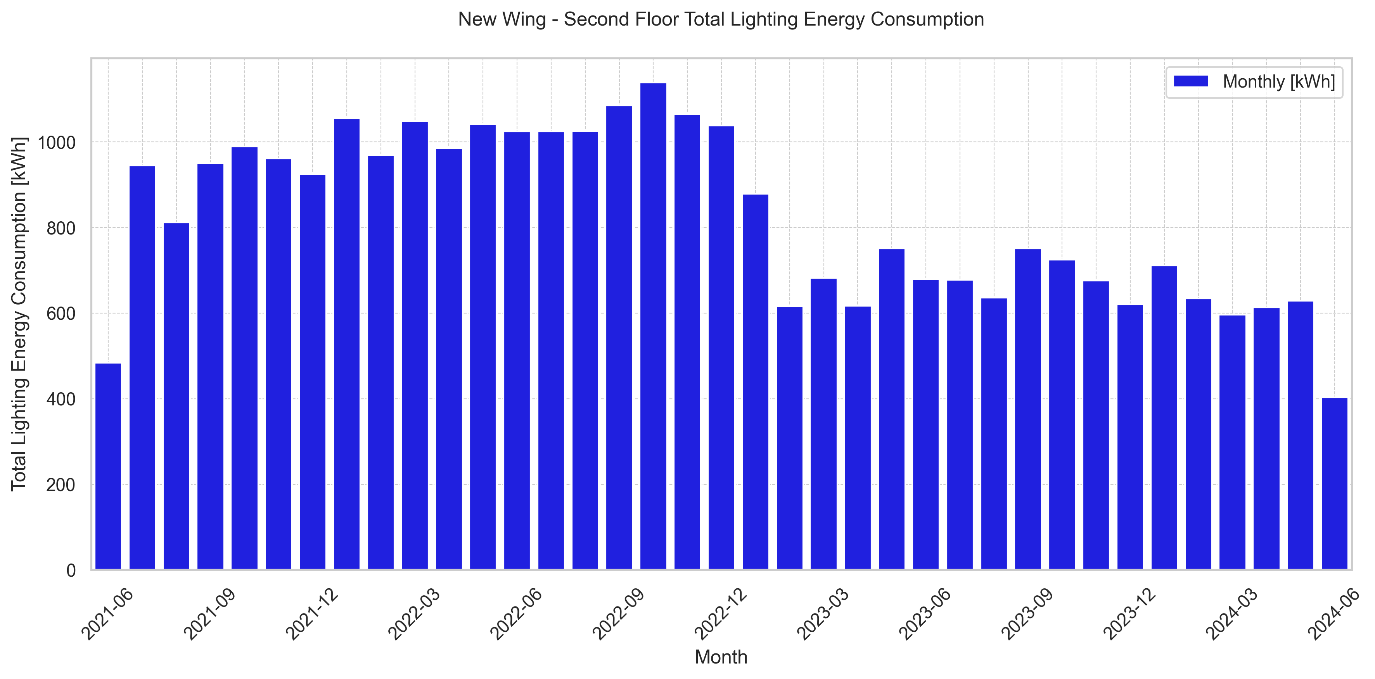
3. Figure

Slide 15
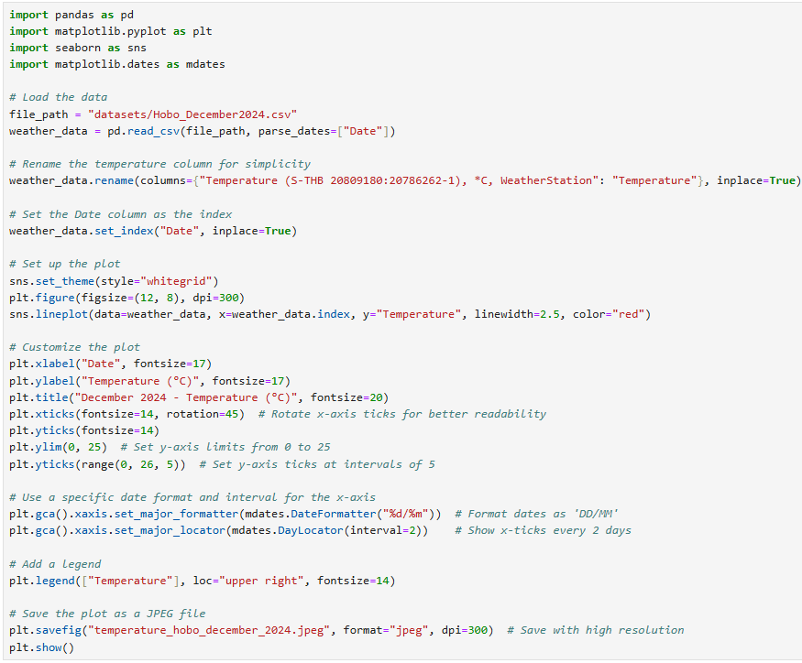
3. Time Series – HOBOlink

Slide 16
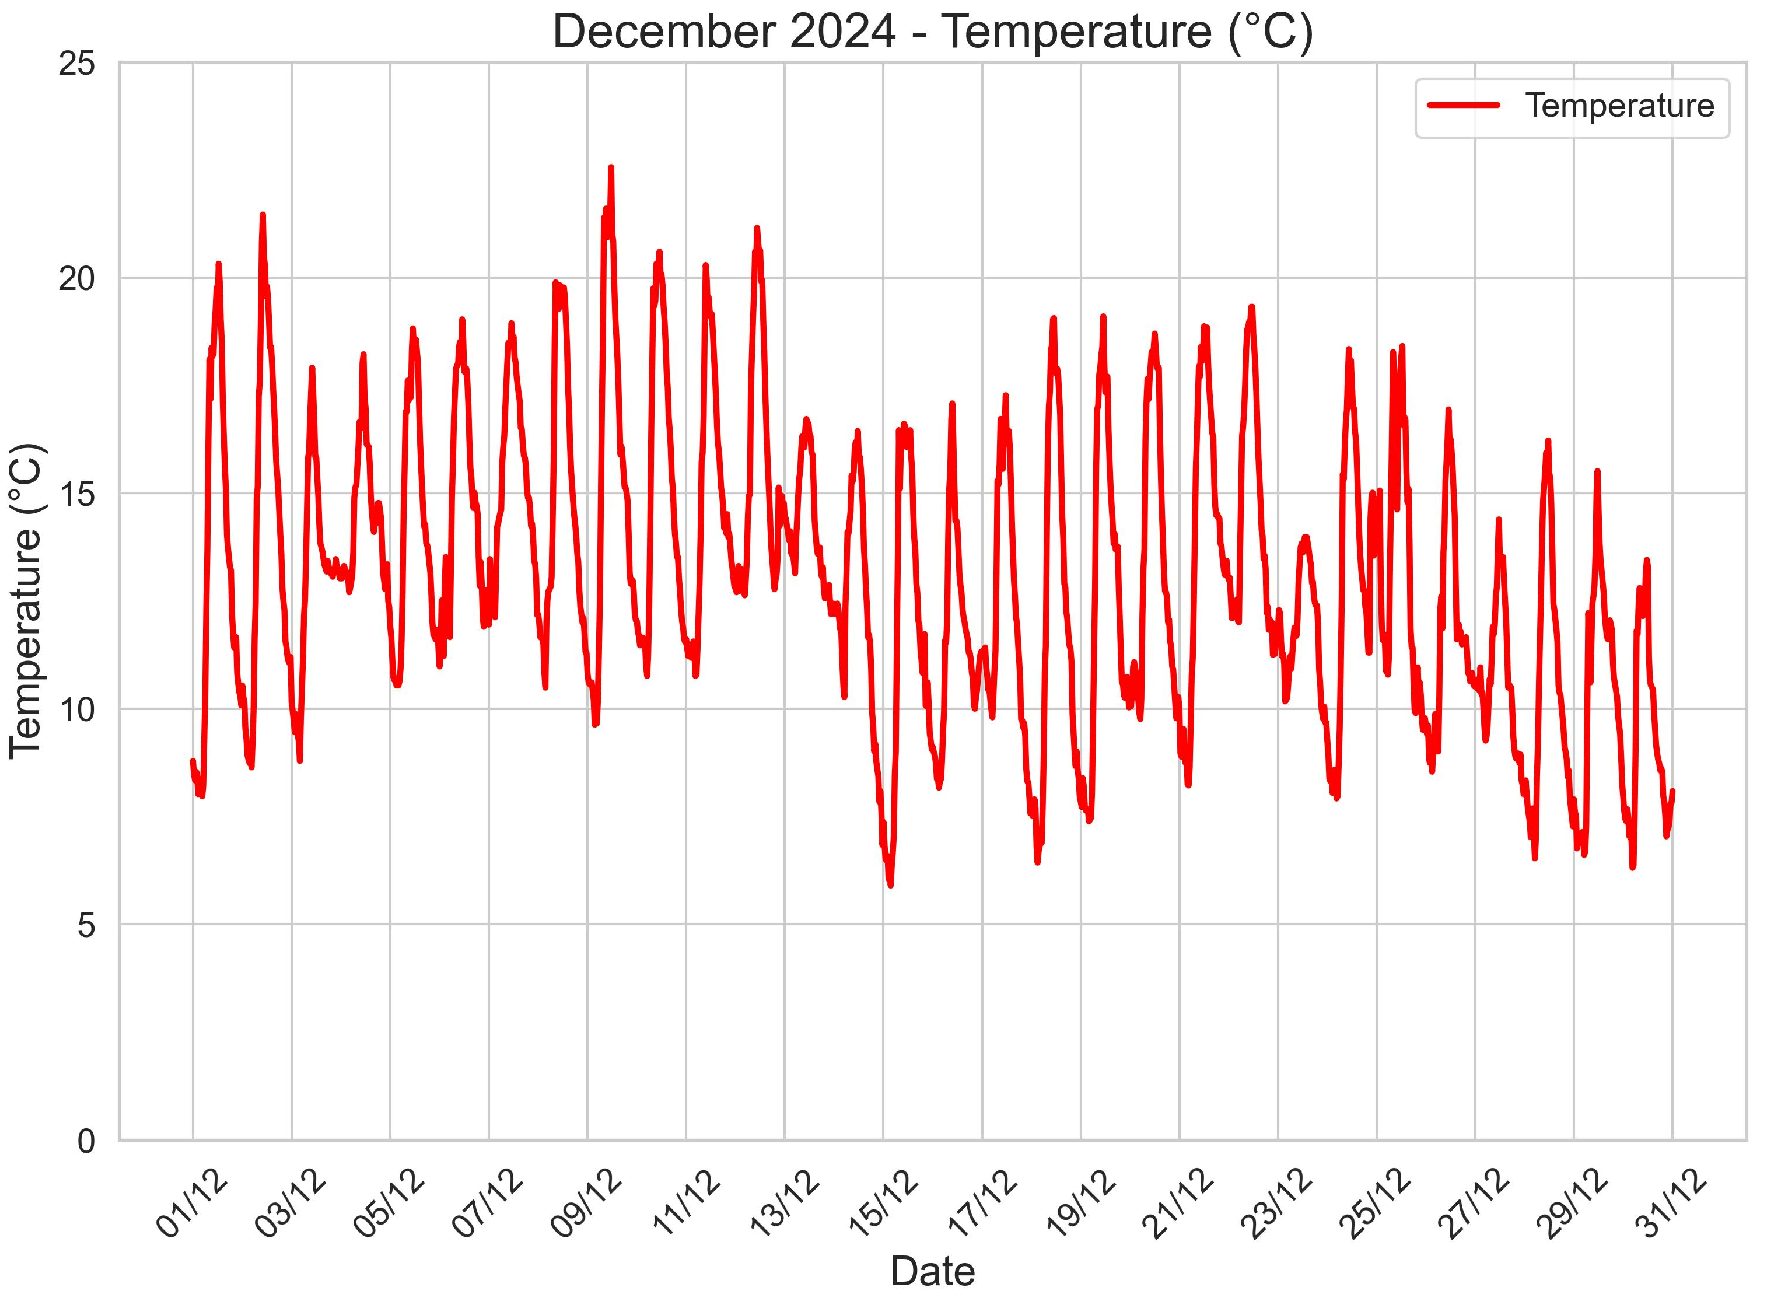
3. Figure

Slide 17
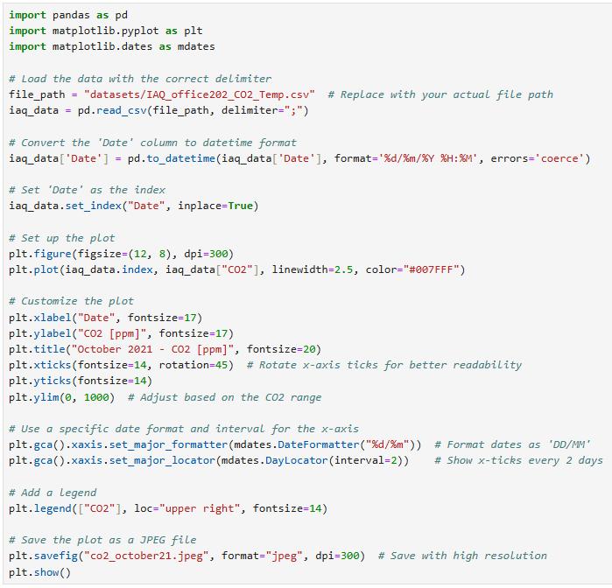
3. Time Series – Indoor Air Quality

Slide 18
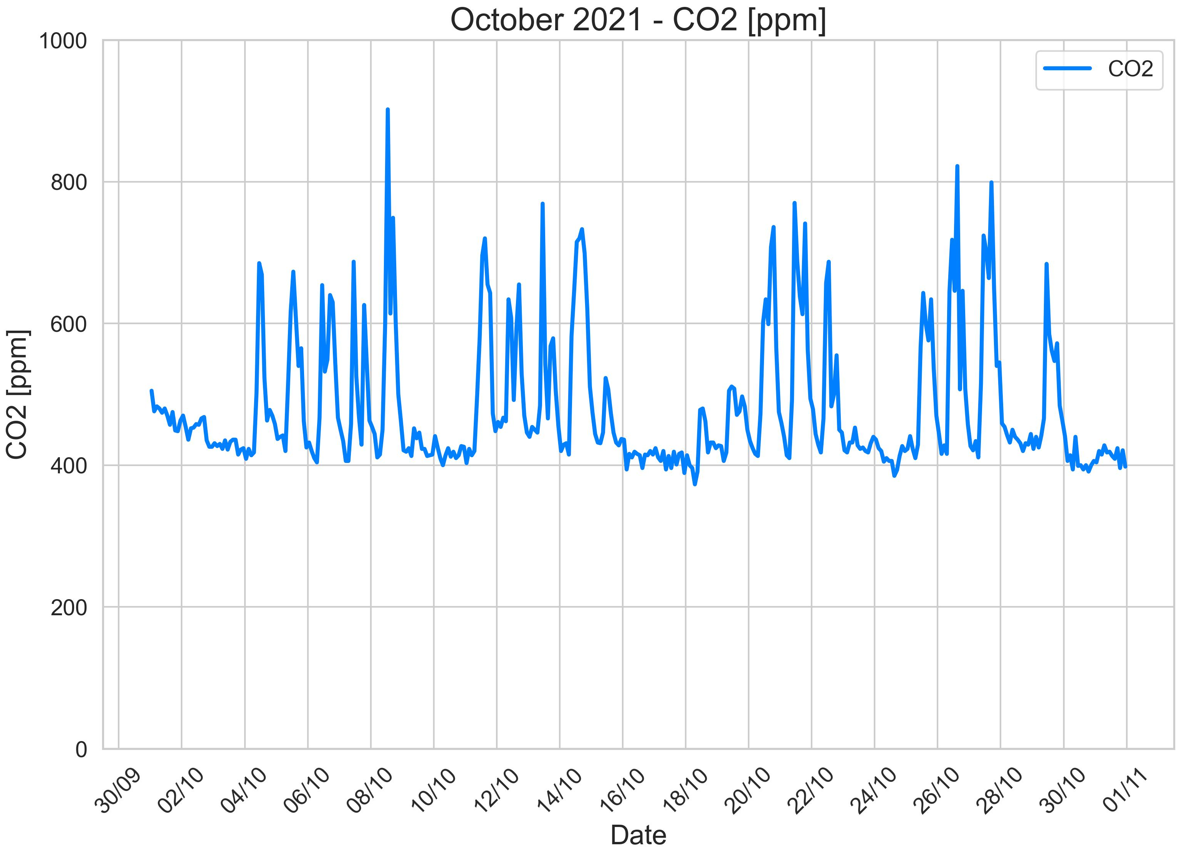
3. Figure

Slide 19
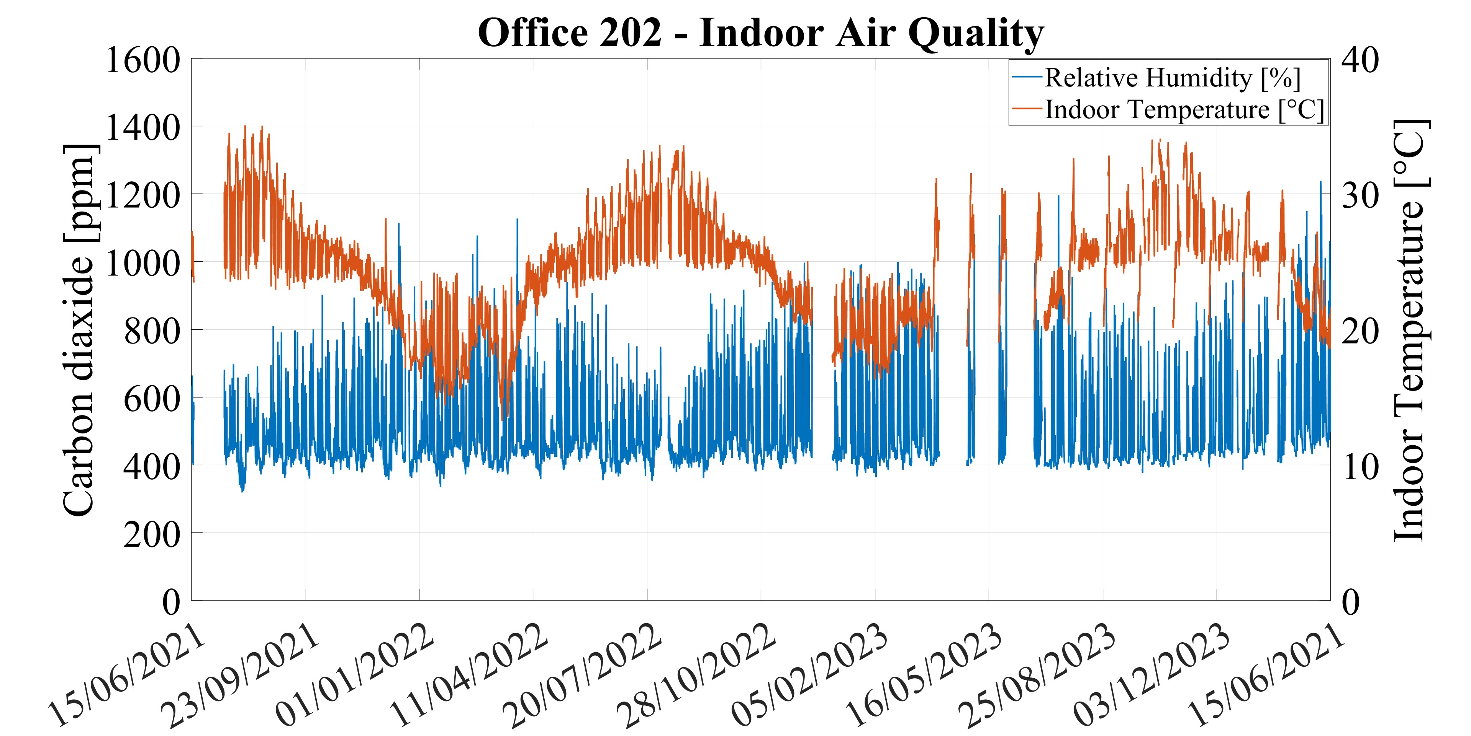
3. Figure

Slide 20
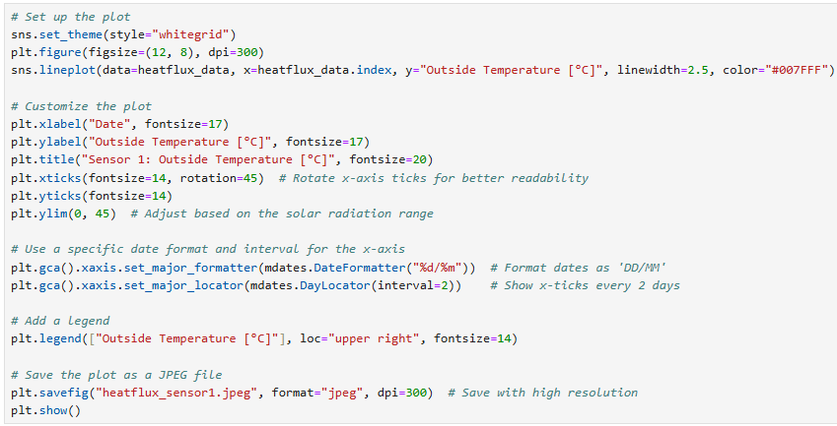
3. Time Series – Heat flux

Slide 21
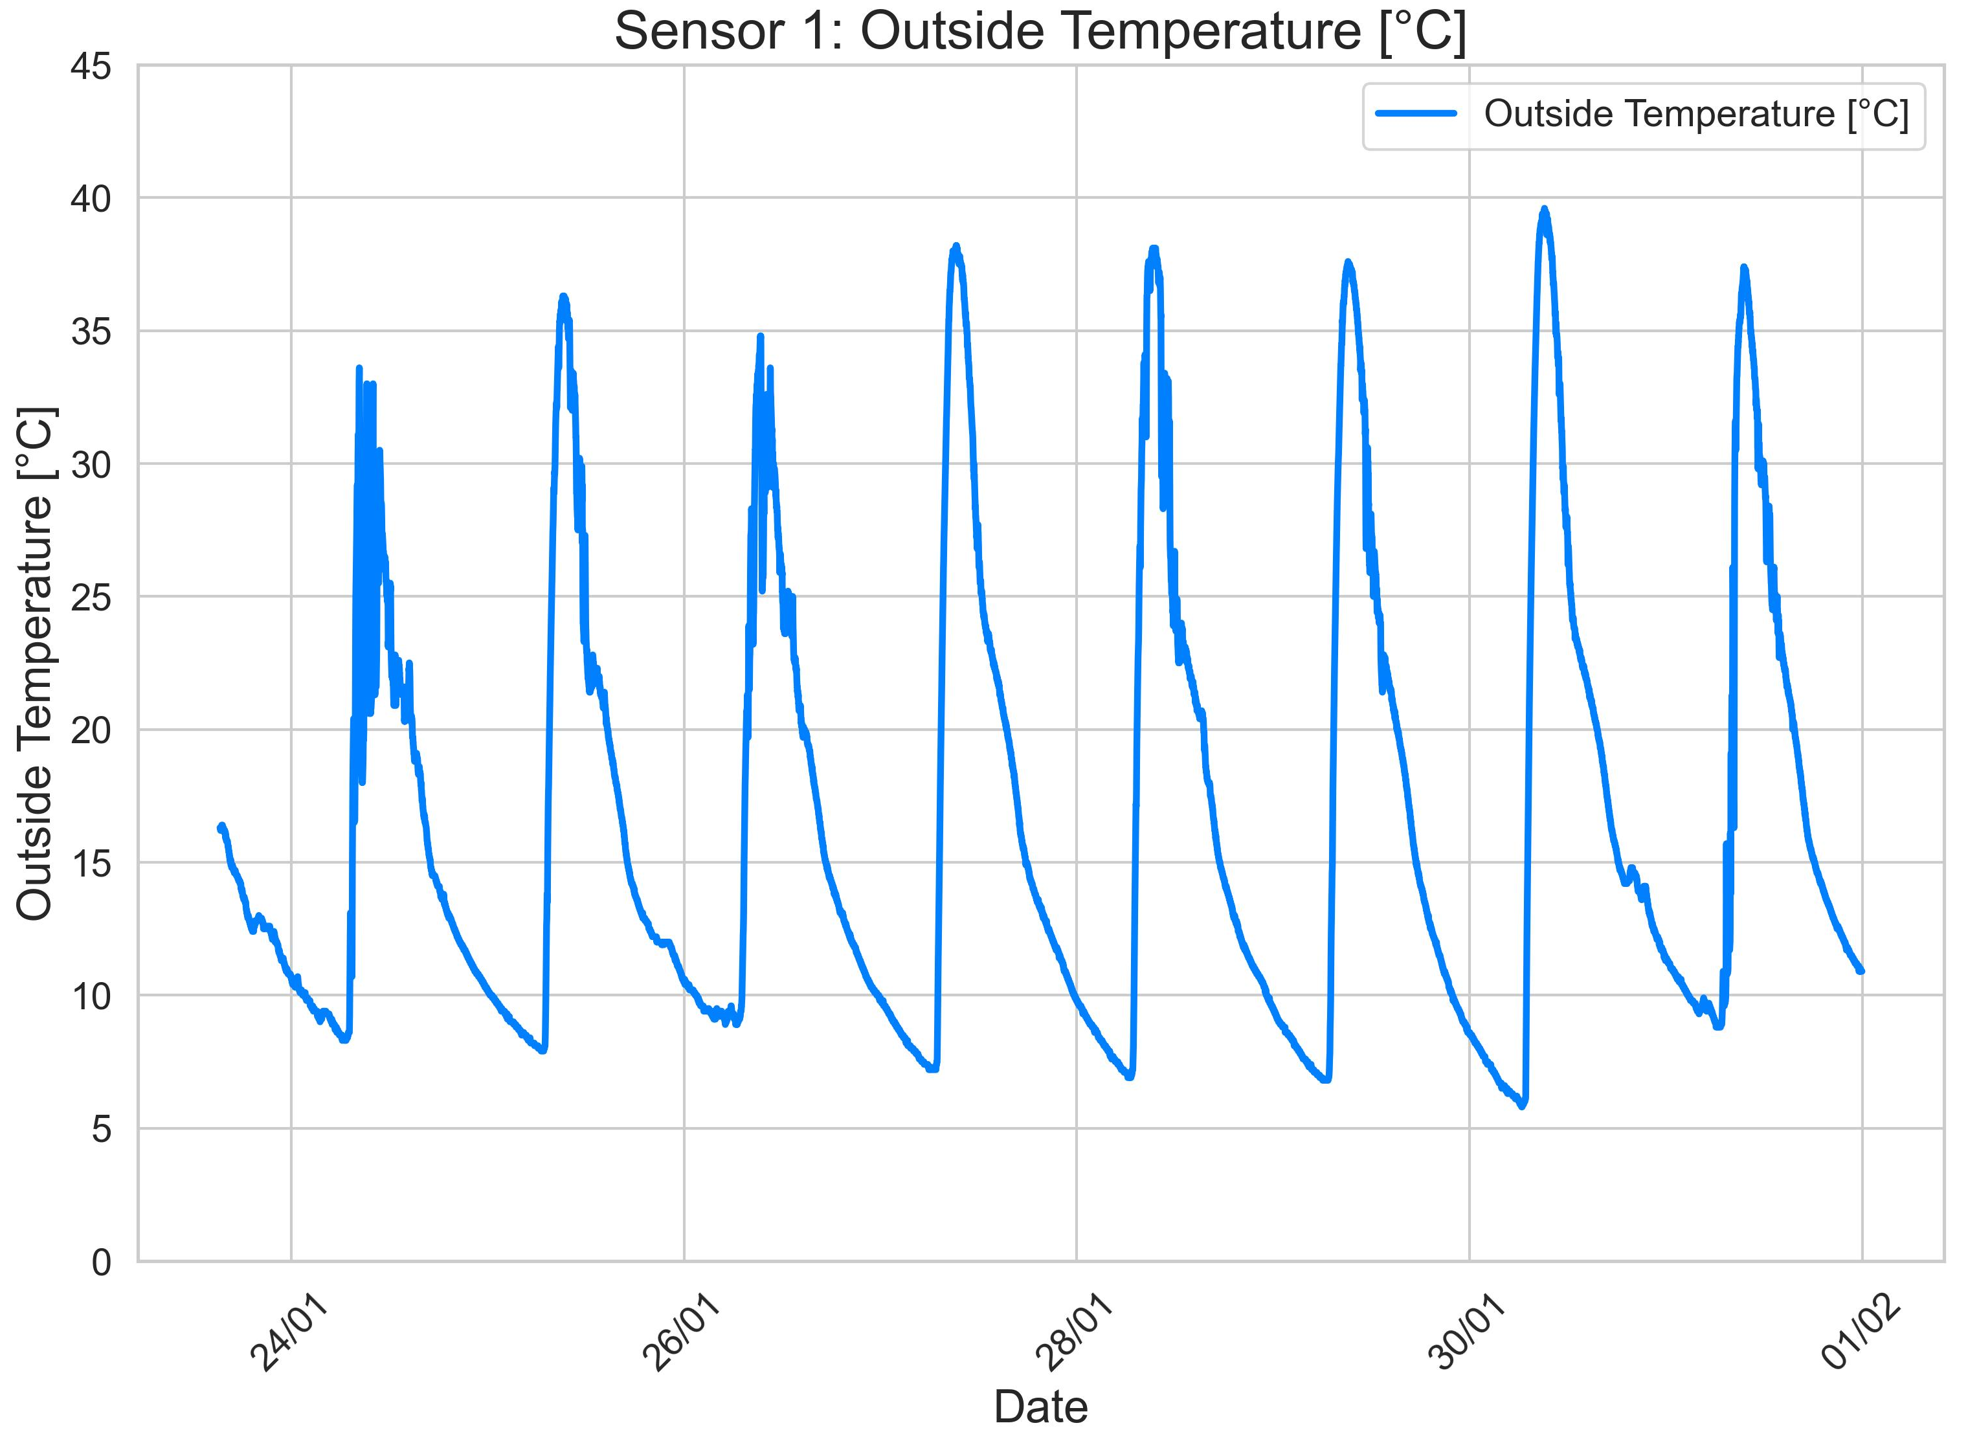
3. Figure

Slide 22
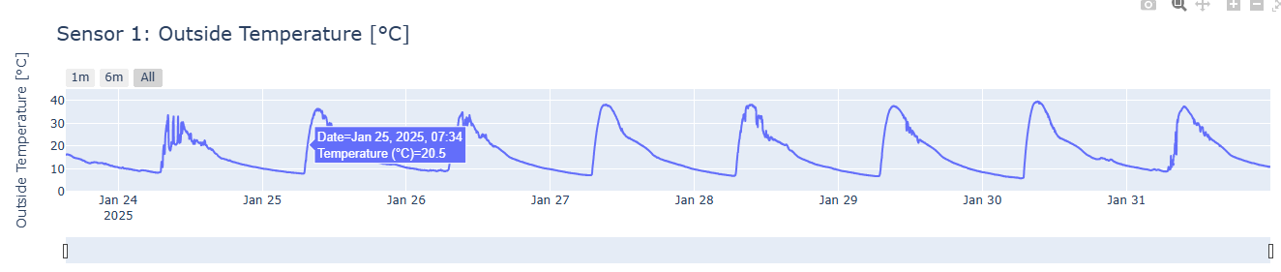
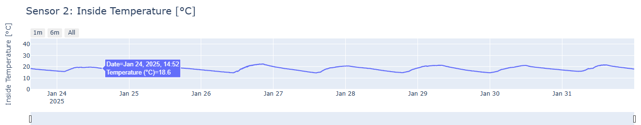
3. interactive Plotly Chart

Slide 23


Thanks!
Any questions?
res.an@frederick.ac.cy
https://www.serg-web.com/
Nikolas Afxentiou
School of Engineering, Frederick University, Cyprus

